Slide 1
Building SVMs
Build SVM Models for Classification
Build SVM Models for Regression

Slide 2

Build SVM Models for Classification

Slide 3
Support-Vector Machines (SVMs)
Decision boundary
Class 0
2.0
Class 1
1.0
Support-vector margin
Support-vector margin
0.0
0.0
1.0
2.0

Slide 4
SVMs for Linear Classification (Slide 1 of 2)
Logistic Regression
Linear Classification with SVMs
2.0
2.0
1.0
1.0
0.0
0.0
0.0
1.0
2.0
0.0
1.0
2.0

Slide 5
SVMs for Linear Classification (Slide 2 of 2)
Logistic Regression
Linear Classification with SVMs
2.0
2.0
1.0
1.0
Test example class = 0
Test example class = 1
0.0
0.0
0.0
1.0
2.0
0.0
1.0
2.0

Slide 6
Hard-Margin Classification (Slide 1 of 2)
2.0
1.0
Hard margin not possible due to outliers
0.0
0.0
1.0
2.0

Slide 7
Hard-Margin Classification (Slide 2 of 2)
2.0
1.0
Margin gap too small
Outlier
0.0
0.0
1.0
2.0

Slide 8
Soft-Margin Classification
2.0
1.0
0.0
0.0
1.0
2.0

Slide 9
SVMs for Non-Linear Classification
2.0
1.0
0.0
0.0
1.0
2.0

Slide 10
Kernel Trick
Kernel Trick: A group of mathematical methods for efficiently representing non-linearly separable data in higher-dimensional space.
Directly mapping features becomes computationally expensive.
Kernel trick avoids this.
Represents data in higher dimensions, without directly computing transformation of features into more dimensions.
Kernel function computes similarity score between examples.
Takes dot product of data in higher dimensions.
Easier than computing actual coordinates.

Slide 11
Hyperplane in Higher Dimensions
2-D Space
3-D Space
2.0
10.0
5.0
1.0
0.0
2.0
0.0
1.0
1.0
0.0
1.0
2.0
2.0
0.0
Hyperplane

Slide 12
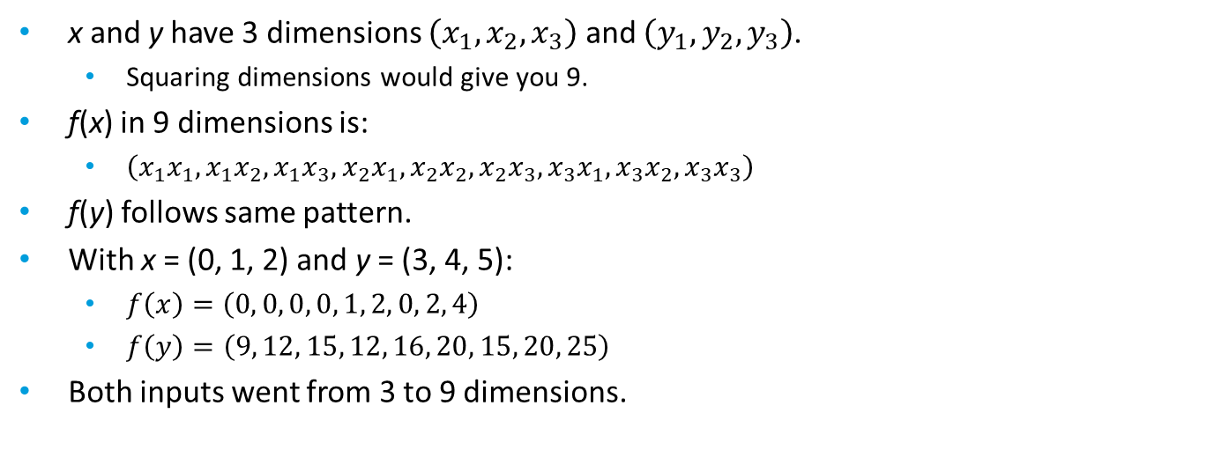

Kernel Trick Example (Slide 1 of 2)
Kernel trick – A simplified equation for how it's performed.
Where:
K is the kernel function.
x and y are the inputs of any n dimension.
f is a function that maps values from n dimension to any higher dimension.
< > represent dot product of f(x) and f(y).
$$K\left(x,y\right)=\left\langle f\left(x\right),f\left(y\right)\right\rangle$$
x and y have 3 dimensions $\left(x_{1}, x_{2}, x_{3}\right)$ and $\left(y_{1}, y_{2}, y_{3}\right)$.
Squaring dimensions would give you 9.
f(x) in 9 dimensions is:
$\left(x_{1}x_{1},x_{1}x_{2},x_{1}x_{3},x_{2}x_{1},x_{2}x_{2},x_{2}x_{3},x_{3}x_{1},x_{3}x_{2},x_{3}x_{3}\right)$
f(y) follows same pattern.
With x = (0, 1, 2) and y = (3, 4, 5):
$f\left(x\right)=\left(0, 0, 0, 0, 1, 2, 0, 2, 4\right)$
$f\left(y\right)=\left(9, 12, 15, 12, 16, 20, 15, 20, 25\right)$
Both inputs went from 3 to 9 dimensions.

Slide 13
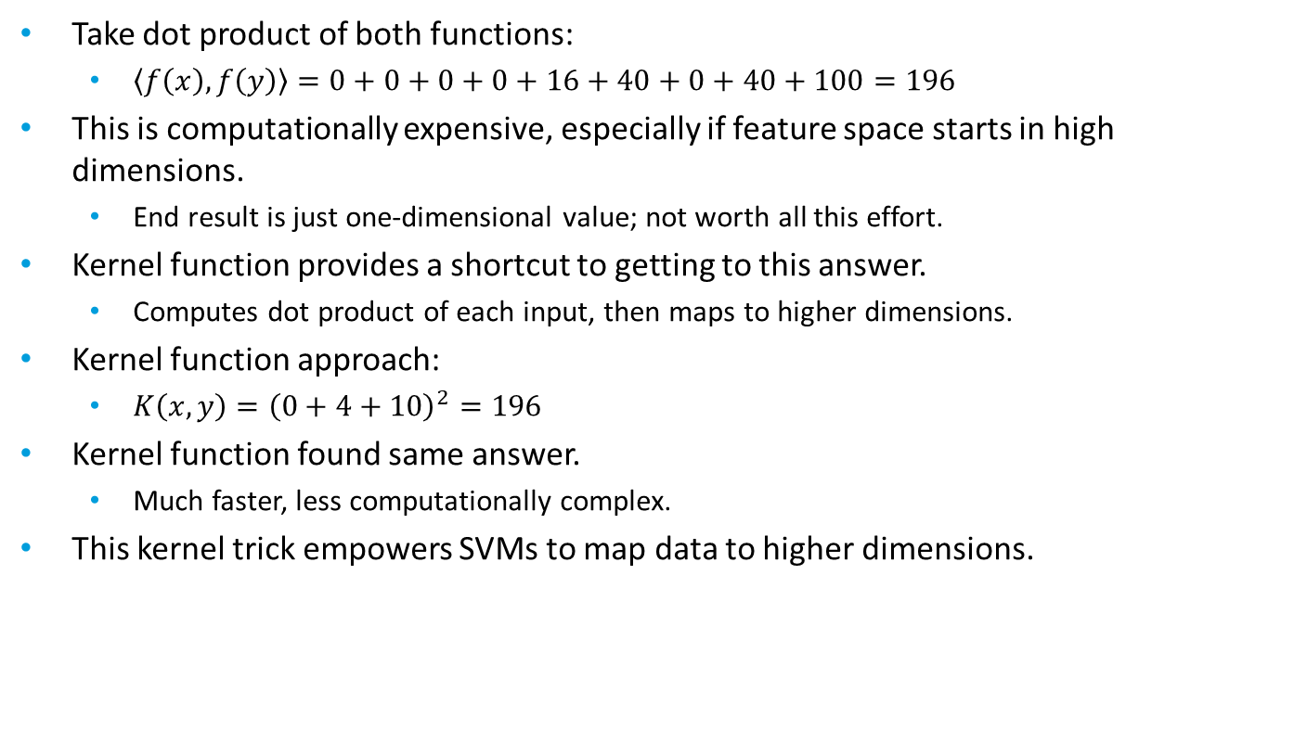
Kernel Trick Example (Slide 2 of 2)
Take dot product of both functions:
$\left\langle f\left(x\right), f\left(y\right)\right\rangle =0+0+0+0+16+40+0+40+100=196$
This is computationally expensive, especially if feature space starts in high dimensions.
End result is just one-dimensional value; not worth all this effort.
Kernel function provides a shortcut to getting to this answer.
Computes dot product of each input, then maps to higher dimensions.
Kernel function approach:
$K\left(x, y\right)={\left(0+4+10\right)}^{2}=196$
Kernel function found same answer.
Much faster, less computationally complex.
This kernel trick empowers SVMs to map data to higher dimensions.

Slide 14
Kernel Methods
Kernel Method | Description
Linear kernel | Simple, only applies to linearly separable data. Useful when feature space is large. Popular in text classification. Good first choice.
Gaussian RBF kernel | Gauss function projects new feature space in higher dimensions. Measures distance between examples and centers. Most effective when examples greatly outnumber features. May be prone to overfitting unless regularized.
Polynomial kernel | Uses polynomial values in feature space projection. High polynomial degree can lead to overfitting; low can lead to underfitting. Less popular than RBF.
Sigmoid kernel | Uses hyperbolic tangent function (tanh). Similar to a perceptron neural network. Used in object detection/image classification.

Slide 15

Build an SVM Model for Classification
Consider SVMs when your problem is sensitive to outliers.
Consider SVMs when you have high-dimensionality data.
Recognize the goal of SVM classification is to keep examples outside wide margins.
Tune regularization hyperparameter to adjust margin size.
Consider that narrow margins may lead to overfitting.
Consider softening the margins to avoid overfitting.
Recognize that softening the margins has a tradeoff.
Apply a kernel trick method to data that is not linearly separable.
Consider the applications of the different types of kernel methods.

Slide 16
Use Python for Classification-Based SVM Models
Use scikit-learn's SVC() class to build a classification-based SVM model:
model = sklearn.svm.SVC(kernel = 'sigmoid', C = 10)
Use same methods and metrics as before.
model.support_
model.support_vectors_

Slide 17
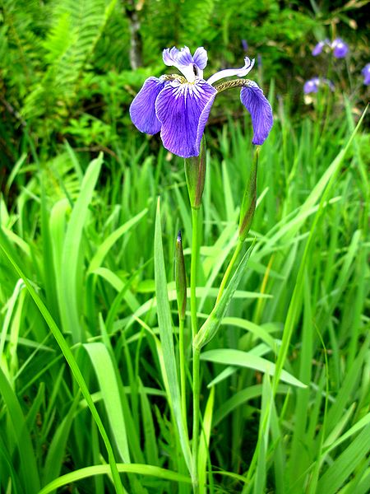
Activity: Building an SVM Model for Classification
Botany department wants students to classify plant species using machine learning.
You've been given a dataset of plants with physical attributes.
Dataset may contain several outliers, so you decide to create an SVM model.

Slide 18
Build SVM Models for Regression

Slide 19
SVMs for Regression
$$ε$$
50
Dependent Variable
0
0
100
Independent Variable

Slide 20
Build an SVM Model for Regression
Consider SVMs for outlier-sensitive problems and high-dimensionality datasets.
Recognize the goal of SVM regression is to keep examples within the margins.
Tune ε hyperparameter to adjust size of margins.
Consider that as ε increases, errors increase.
Consider that as ε decreases, model becomes more prone to overfitting.

Slide 21
Use Python for Regression-Based SVM Models
Use scikit-learn's SVR() class to build a regression-based SVM model:
model = sklearn.svm.SVR(kernel = 'rbf', epsilon = 10)
Use same methods and metrics as before.
Use same model attributes as with classification.

Slide 22
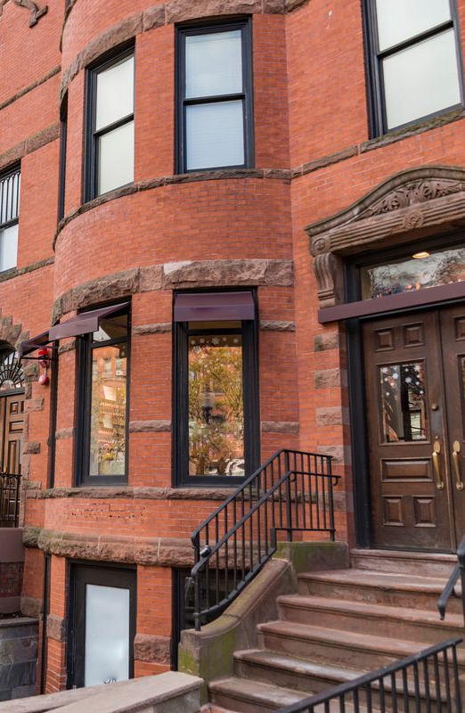
Activity: Building an SVM Model for Regression
You've trained a linear regression model on the Boston housing dataset.
However, there are some outliers that may be negatively affecting the model's skill.
You'll train a model using SVMs to see if you can improve the model.

Slide 23
In your own business environment, how might you use SVMs to solve classification problems?
In your own business environment, how might you use SVMs to solve regression problems?

